Slide 1


Shield Insurance
Presented by: Janaki Patel

Slide 2
About Company
A leading provider of insurance to Individuals and Business.
Operating in major cities like Delhi, Chennai, Ahmedabad, Indore and Mumbai.
Offering nine different types of insurance policies.

Slide 3
Objective
The objective of the project is to
Analyse the Revenue and Customer growth and its trends over time.
Policy impact of age groups on Business.
Analysis of different sales mode.
Settlement amount statistic.
These insights will provide a clearer understanding of the company's strengths and areas for improvement, guiding strategic decision-making.

Slide 4
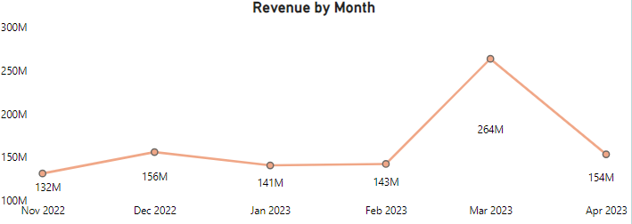
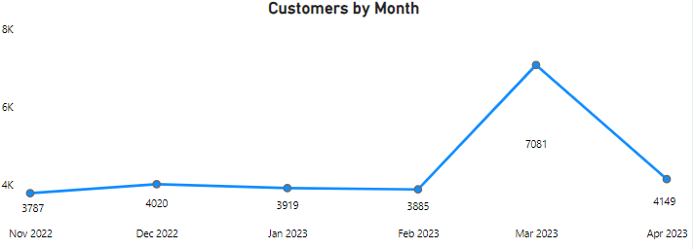
Key Insights – Revenue and Customer Analysis
The Revenue and Customers from Nov-22 to Feb-23 has been pretty much same.
But in the month of Mar-23 the revenue increased by 85% to 264 M but drooped by 41% to 154M in following month.
Customers increased by 83% in Mar-23 but dropped by 40% in Apr-23.

Slide 5
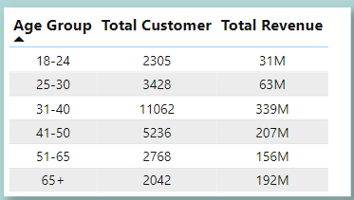
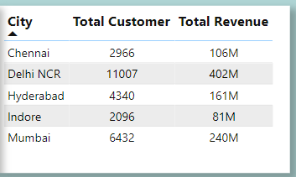
Age Group and City analysis for Revenue and Customer
Customers base and Total Revenue are highest among 31-40 Age group.
Delhi NCR shows Highest Total Customer and Total Revenue count while Indore shows the least.

Slide 6
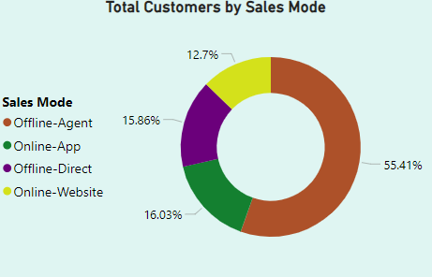

Sales Mode Analysis
Offline – Agent Sales mode attracted more Customer and generated highest Revenue compared to other Sales Mode.

Slide 7
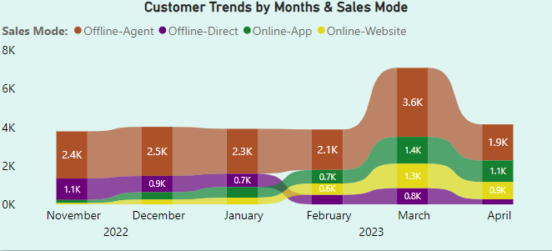
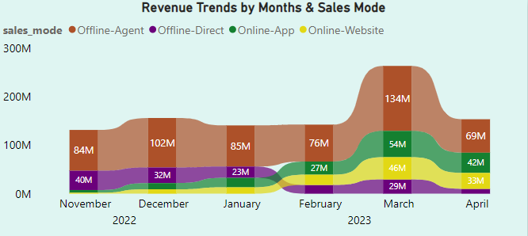
Sales Mode Analysis
Following Jan-2023, Offline Direct Sales Mode shows decline in both Revenue and Customers.
Online App and Website shows increase in Revenue and Customer post Jan 2023, indicating customer preference shift to Digital Platforms.

Slide 8
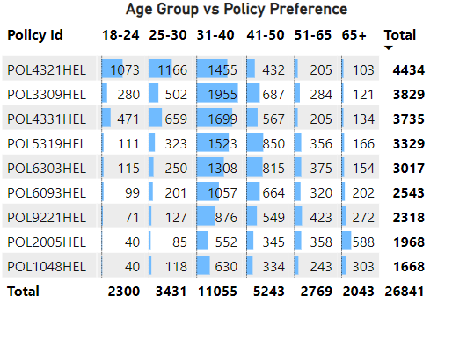
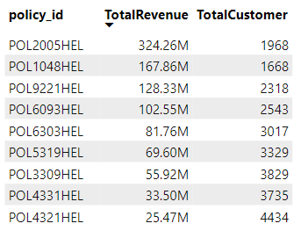
Policy Analysis
POL4321HEL policy is preferred most by Customers but generates less revenue due to less base premium of ₹5,000 and coverage of ₹2,00,000.
POL1048HEL policy is preferred low by customer but generates more revenue due to high base premium amount of ₹76,500 and coverage of ₹50,00,000.
POL2005HEL policy generates highest revenue with low customers with premium amount of ₹1,20,000 and coverage of ₹1,00,00,000.
Policy Preference is highest among 31-40 Age Group.

Slide 9
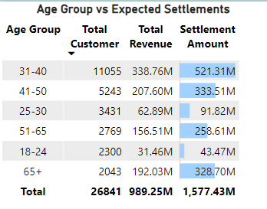
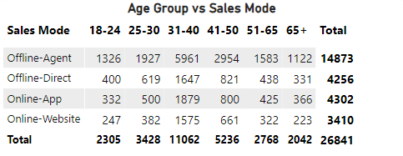
Age-Group Analysis
Offline – Agent Sales mode attracted more Customer major with age group between 31-40 years.
Age-group of 31-40 has the highest settlement amount and Revenue followed by age-group of 41-50 and 65+.
Age-group 18-24 has the lowest settlement amount and Revenue.
Customer is lowest with 65+ Age group but it generates good Revenue.

Slide 10
Recommendations
Focus on the age group which generates low Revenue and also has low customer base.
Investigate the reasons behind the decline in revenue for the offline direct sales mode to identify potential areas for improvement.
Enhance the online app and website, as revenue from these channels has shown growth. Improving user experience on these platforms could significantly drive further sales.
Allocate more resources to marketing and promoting POL1048HEL and POL2005HEL policies. Highlighting the unique features and benefits of these policies in targeted advertising campaigns will help attract new customers.
Develop targeted marketing strategies or customize policies for cities with low customer acquisition and revenue generation to drive growth in these regions.

Slide 11
Thank You

